Slide 1
PBL Presentation Phase –2
Parking Management App for Android
Presented By
Mr. PRAJWAL R 1BY18IS084
Mr. PRASHANTH R 1BY18IS089
Mr. RAGHAVENDRA K M 1BY18IS093
Ms. SUGANDHA SINHA 1BY18IS119
Under the guidance of
Prof. Mahalakshmi S
Asst Professor/ Dept of ISE
BMSIT&M

Slide 2
Content
Introduction
Objectives
Methodology
Implementation
Results
Conclusion
References

Slide 3
Introduction
Parking is one of the major challenge faced by urban areas.
Reduce wastage of fuel and time.
Display Available Parking Space.
Bill Generation for the parking time.
Records of all the cars parked at the parking spot.
12-07-2021
3

Slide 4

Objectives
To reduces the manpower and traffic congestion.
To improve the performance and satisfy the need of free parking slot.
To reduce the time wastage in finding the vacant parking lot.

Slide 5
Methodology
l
Not registered?
Register
NO. OF AVAILABLE SLOT
.
LOGIN
Email Id
Enter Vehicle Number
Password
Added Successfully
Enter vehicle info
IN
Check Available Space
LOGIN
History
OUT
Data will be stored
in firebase.
Detail of Total space and Available Space in all parking slot with area name.
REGISTER
NAME
Email Id
Password
Phone No.
History of all the cars with specific date and time.
BILL
VEHICLE NO.
ENTRY TIME
EXIT TIME
PAYMENT AMOUNT
REGISTER
Login
Data will be stored
in firebase.
Data will be stored
in firebase.

Slide 6
Implementation
Click here
SAMPLE CODE / LINK TO CODE

Slide 7
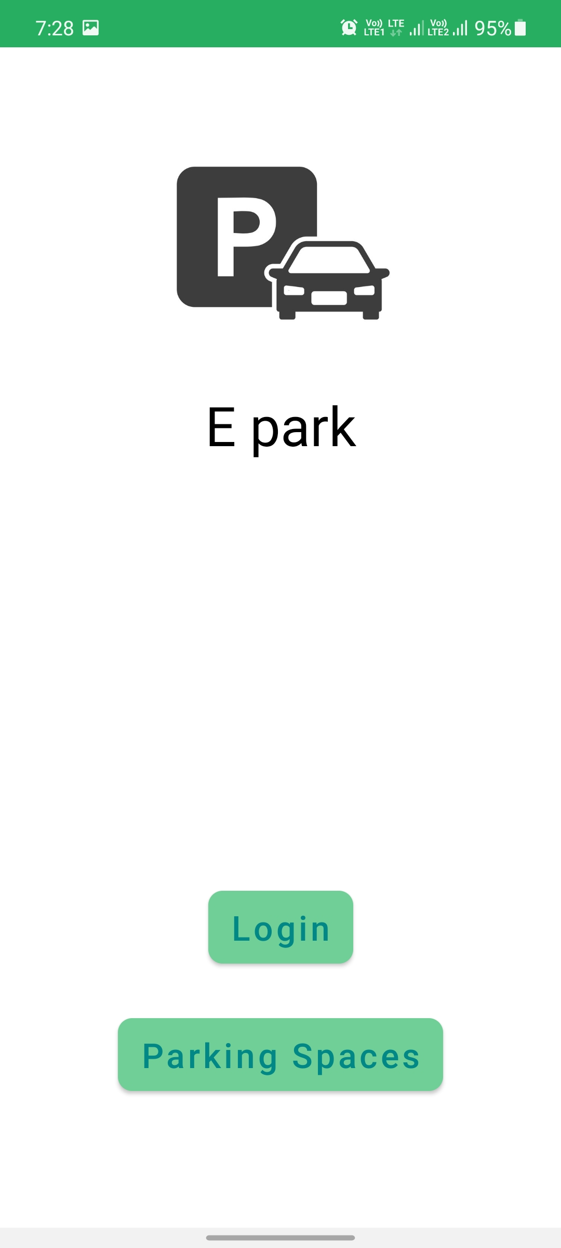
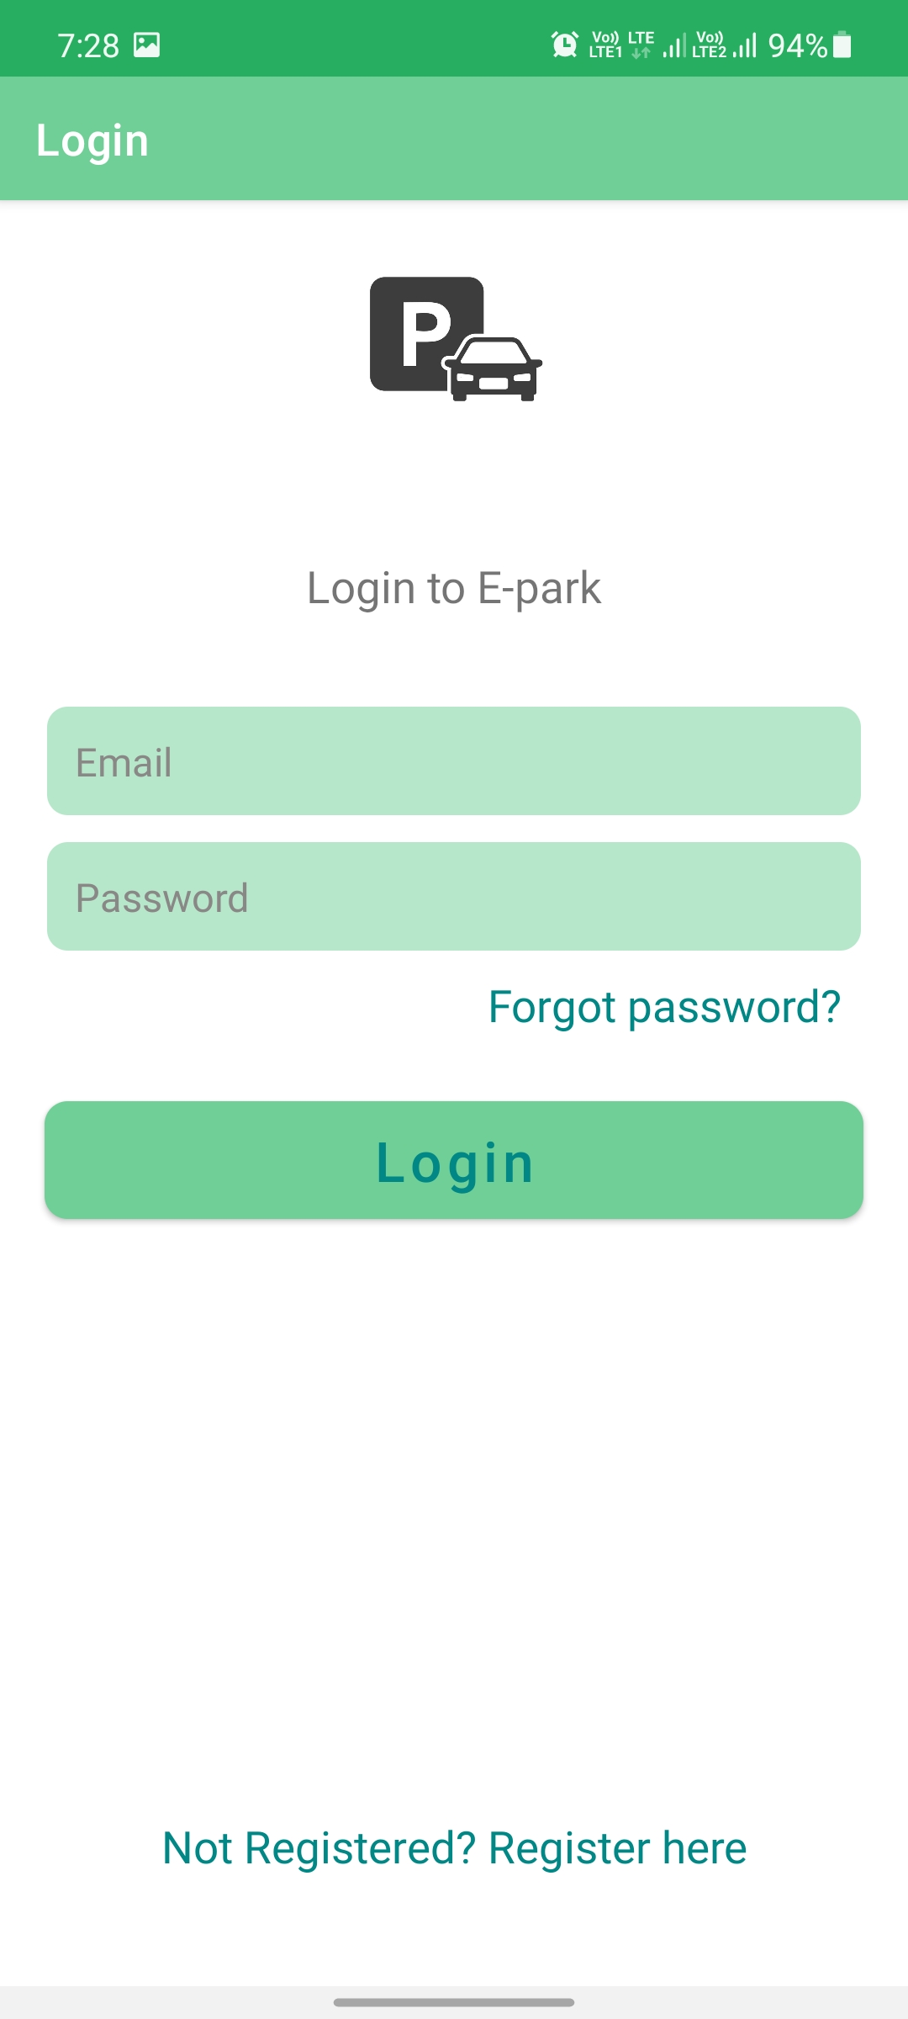
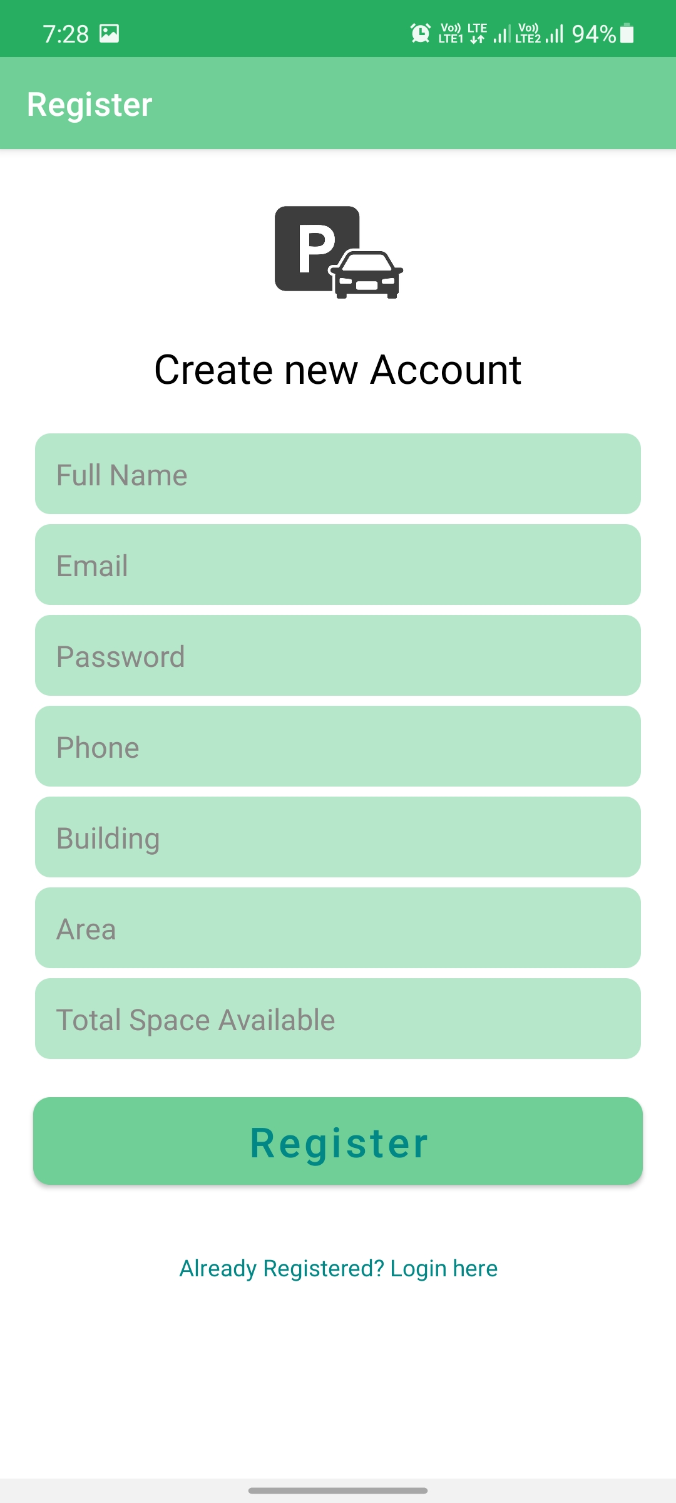
Results
.

Slide 8
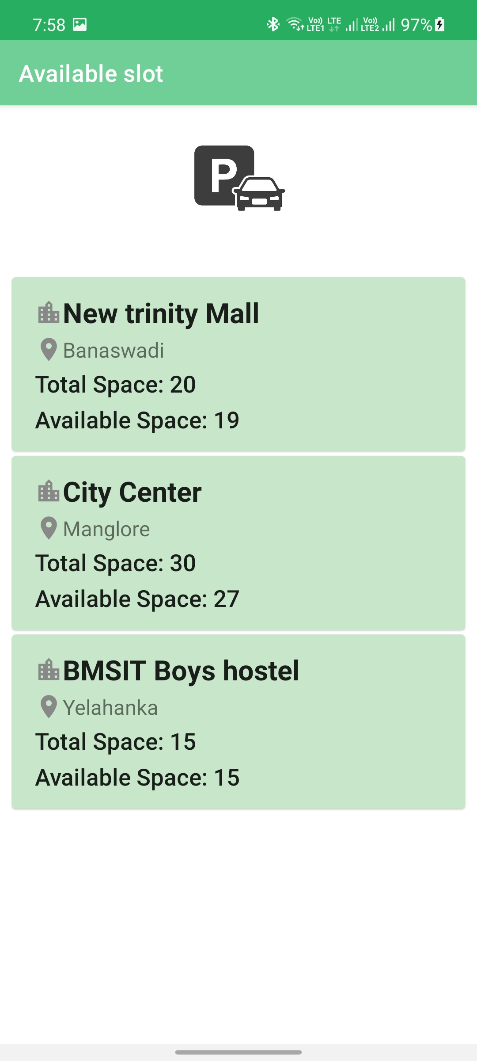
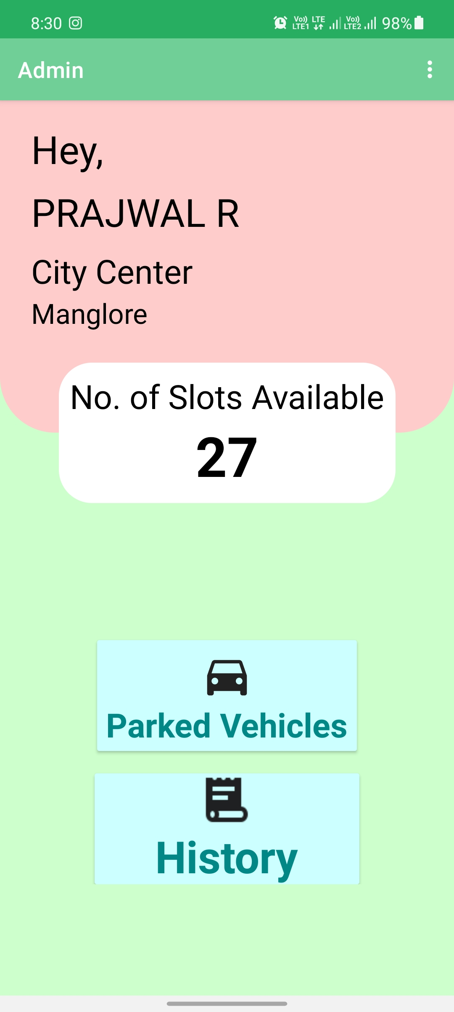

Slide 9
Conclusion
The app also helps in bill generation there by reducing tedious work.
Keep record of all the cars parked at the parking spot with date and time.
A Parking Management App is a wide field which can be implemented using many different technique.
The proposed app will allow normal user to know about the parking space availability.

Slide 10
References
C. Ng, S. Cheong, E. Haji mohammad hosseinmemar and W. Yap, "Mobile outdoor parking space detection application," 2017 IEEE 8th Control and System Graduate Research Colloquium (ICSGRC), 2017, pp. 81-86, doi: 10.1109/ICSGRC.2017.8070573.
B. K. Patil, A. Deshpande, S. Suryavanshi, R. Magdum and B. Manjunath, "Smart Parking System for Cars," 2018 International Conference on Recent Innovations in Electrical, Electronics & Communication Engineering (ICRIEECE), 2018, pp. 1118-1121, doi: 10.1109/ICRIEECE44171.2018.9008662.

Slide 11

Thank You

